Slide 1

Secure key vault
Md. Sahidul Islam

Slide 2
What is SKS?
Key Vault refers to a service that protects encryption keys and secrets like certificates, connection strings, and passwords.
Secrets Management
Key Management
Certificate Management
kv/secret/foo
secret/foo
Client
Vault
Policy

Slide 3
Why SKS?
Centralize application secrets
Securely store secrets and keys
Monitor access and use
Drawbacks of common approaches
Stored in the image ➔ Open for all
Environment variables ➔ Could appear in debug logs
Secrets mounted in volumes ➔ Each container only needs a small subset of secrets

Slide 4
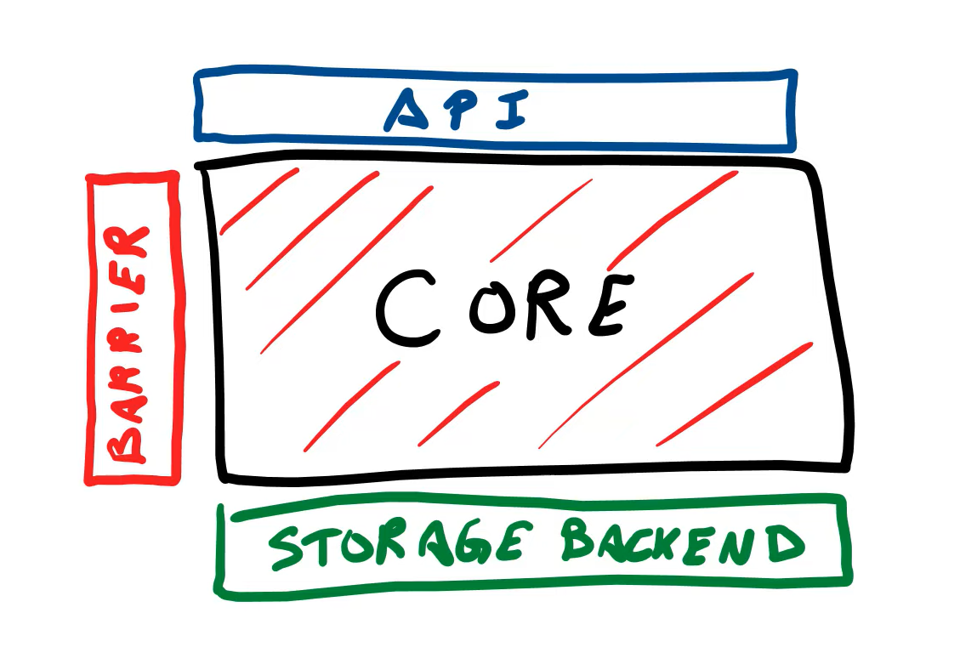
Key Terms
Secret Engine
Auth Method
Policy
Audit Device
Storage Backend

Slide 5
Popular Key Vault Services
Azure key vault
HashiCorp Vault
Egnyte
1Password
AWS Certificate Manager

Slide 6
Why HashiCorp Vault?
It’s open source
It is self-hosted
Other advantages
Name | Pricing |  | Remarks
Azure Key Vault | 0.03 USD/10k transactions
HashiCorp Vault | Criterion | Price | Self-Hosted and Managed version is free. So I will choose this one.
 | Open Source | Free
 | Cloud | 0.03 USD/ 3 hours
 | Enterprize | Custom
Egnyte | 20 USD per employee/Month
Amazon Certificate Manager | Complex, Go to link

Slide 7
How do I set up Hashicorp Vault?
Download Vault
Install Vault
Configure systemd
Configure Consul
Configure Vault
Start Vault

